Slide 1

Hdfs (Hadoop distributed file system)

Slide 2
HDFS Goals & Assumptions

Slide 3
HDFS Basics
An open-source implementation of Google File System
Assume that node failure rate is high
Large files, some several GB large
Write-once-ready-many pattern
Reads are performed in a large streaming fashion
Large throughput
Moving computation is easier than moving data

Slide 4
HDFS Files
User data divided into 64MB blocks and replicated across local disks of cluster node to address:
Cluster network bottleneck
Cluster node crashes
Master/Slave Architecture
Master (Namenode) maintains a name space and metadata
Slaves (Datanodes): maintain three copies of each data block

Slide 5
Master / Slave Architecture

Slide 6
Namenode
Abitrator and repository for all HDFS metadata
Data never flows through Namenode
Executes file system namespace operations
open, close, rename files and directories
Determines mapping of blocks to Datanodes

Slide 7
EditLog & FsImage
Managed by Namenode
Stored in files on the local OS file system
EditLog
Transaction log
Records all changes to file system metadata
FsImage
Image of entire file system namespace
Mappings of blocks to files
File system properties
Stored in a file on the local OS file system

Slide 8
Datanodes
Serve read / write requests from client
Block creation, deletion and replication upon instruction from Namenode
Stores HDFS data in files on local file system
Determines optimal file count per directory
Creates subdirectories automatically

Slide 9
Communication

Slide 10
Communication Protocols
Layered on top of TCP/IP
RPC abstraction wraps protocols
ClientProtocol
Client talks to Namenode
Datanode Protocol
Datanodes talk to Namenode
Namenode never initiates any RPCs
It only responds to RPC requests

Slide 11
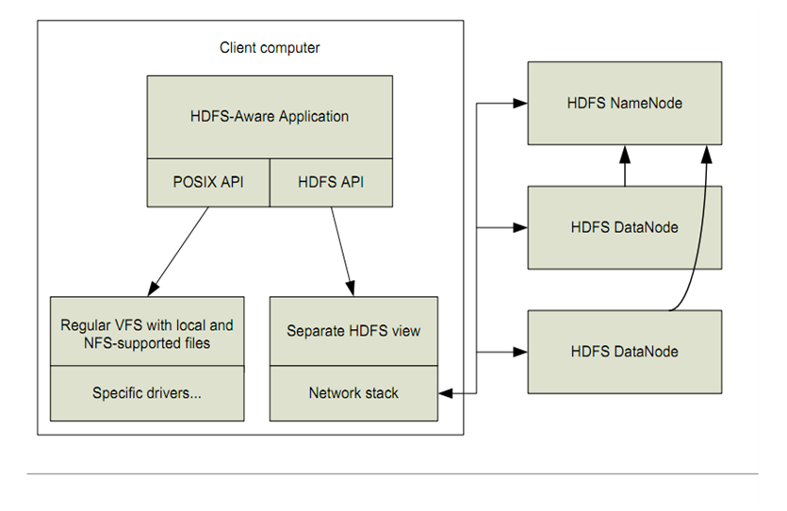
HDFS Client Block Diagram

Slide 12
HDFS: Hadoop Distributed File Systems
Client requests meta data about a file from namenode
Data is served directly from datanode
Application
HDFS namenode
(file name, block id)
HDFS Client
(block id, block location)
File namespace
/user/css534/input
block 3df2
instructions
state
(block id, byte range)
HDFS datanode
HDFS datanode
block data
Linux local file system
Linux local file system
…
…

Slide 13
File Read/Write in HDFS
File Read
File Write
1. open
Distributed
FileSystem
2. get block locations
1. create
Distributed
FileSystem
2. create
name node
name node
HDFS
client
NameNode
HDFS
client
NameNode
3. read
3. write
8. complete
FSData
InputStream
FSData
OutputStream
6. close
7. close
client JVM
client JVM
4. get a list of 3 data nodes
client node
client node
4. read from the closest node
5. write packet
6. ack packet
5. read from the 2nd closest node
data node
data node
data node
data node
data node
data node
DataNode
DataNode
DataNode
DataNode
DataNode
DataNode
If a data node crashed, the crashed node is removed, current block receives a newer id so as to delete the partial data from the crashed node later, and Namenode allocates an another node.

Slide 14
Data Replication

Slide 15
Replica Placement
Distinguishes HDFS from most other DFS
When replication factor == 3
Put one replica on local rack
Put one replica on different node on local rack
Put one replica on different node on different rack
Replicas do not evenly distribute across racks

Slide 16
Start-Up Process
Namenode enters Safemode
Replication does not occur in Safemode
Each Datanode sends Heartbeat
Each Datanode sends Blockreport
Lists all HDFS data blocks
Namenode creates Blockmap from Blockreports
Namenode exits Safemode
Replicate any under-replicated blocks

Slide 17
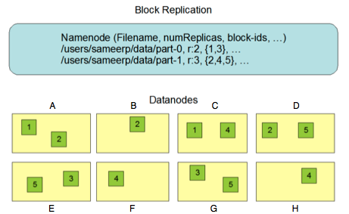
Datanode Blockreports

Slide 18
Checkpoint Process
Performed by Namenode
Two versions of FsImage
One stored on disk
One in memory
Applies all transactions in EditLog to in-memory FsImage
Flushes FsImage to disk
Truncates EditLog

Slide 19
Robustness / Fault Tolerance

Slide 20
Datanode Failure
Datanode sends periodic Heartbeats
Namenode
Datanode
Datanode
Datanode

Slide 21
Datanode Failure
Namenode marks Datanodes without recent heartbeat as dead
Does not forward any new I/O requests
Constantly tracks which blocks must be replicated with BlockMap
Initiates replication when necessary

Slide 22
Namenode Failure
Single Point of Failure for HDFS cluster
FsImage and EditLog are central data structures for HDFS
Corruption / loss of these files causes HDFS to become non-functional
Manual intervention is necessary

Slide 23
Limitations

Slide 24
Limitations
Write-once model
A namespace with an extremely large number of files exceeds Namenode’s capacity to maintain
Cannot be mounted by exisiting OS
Getting data in and out is tedious
Virtual File System can solve problem
Java API
Thrift API is available to use other languages

Slide 25
Limitations
HDFS does not implement / support
User quotas
Access permissions
Hard or soft links
Data balancing schemes
No periodic checkpoints
Namenode is single point of failure
Automatic restart and failover to another machine.

Slide 26
Research and Extensions

Slide 27
Hive
Facebook Data Infrastructure Team
700TB of data
Tens of thousands of tables
Over 200 users per month
Open-source data warehousing solution built on top of Hadoop
HiveQL: a SQL-like query language
Compiled into MapReduce jobs
Able to plug in MapReduce scripts into queries

Slide 28
Wordcount in Hive
FROM (
MAP doctext
USING ‘python wc_mapper.py’
AS (word, cnt)
FROM docs
CLUSTER BY word
) a
REDUCE word, cnt
USING ‘python_wc_reduce.py’;

Slide 29
Energy Efficiency
Data availability maintained even though node may be idle computationally
MapReduce tasks/data may underutilize the node
Solutions
Hadoop could communicate with nodes to put them in low-power modes when possible
Hadoop could aggregate tasks and data to more fully utilize nodes, keeping other nodes powered down
Trade-off between energy usage and performance of MapReduce, can achieve good enough performance at significant energy savings

Slide 30
Reference
The Hadoop Distributed File System: Architecture and Design by Apache Foundation Inc.

